Slide 1


Piano with Lasers
Presented By : The Assembly Team

Slide 2
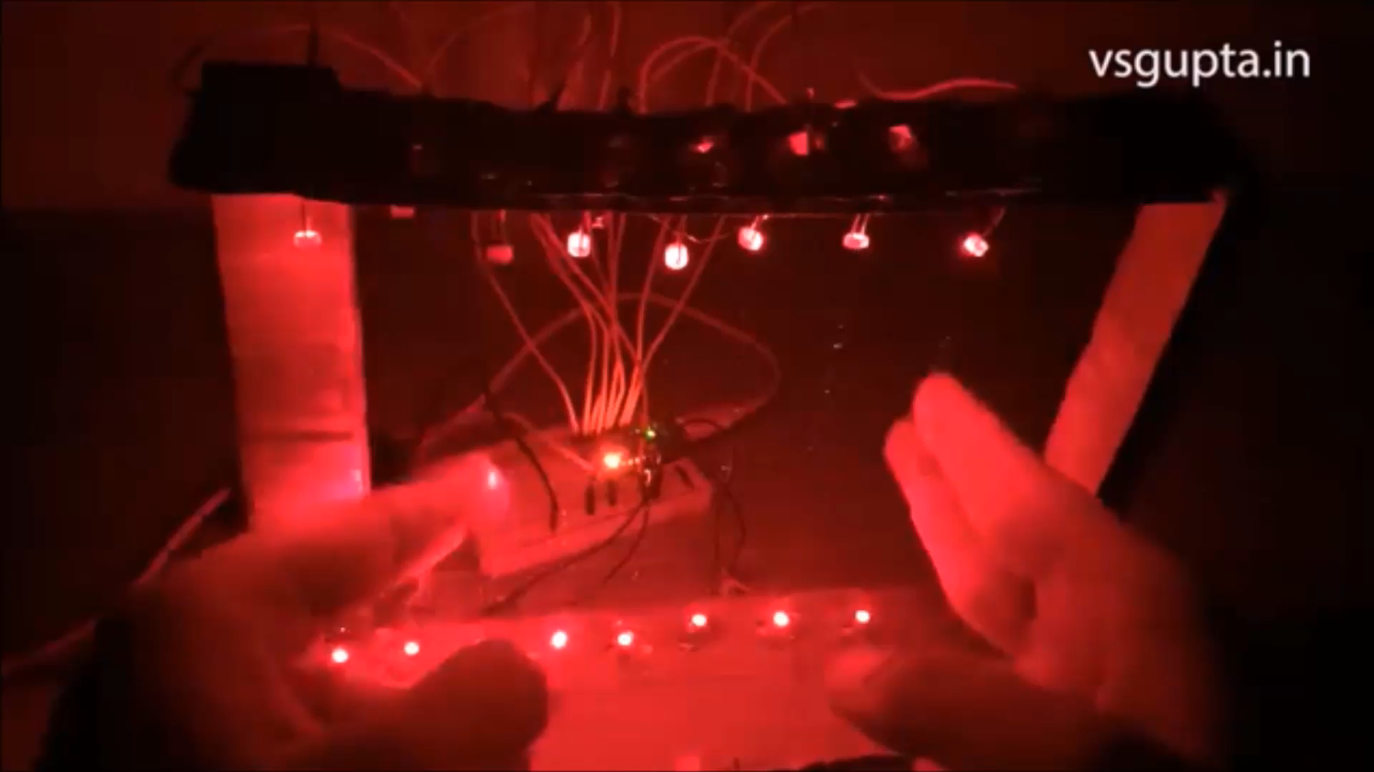
Why make it?
Growing up almost everyone played with a piano. While exploring the Arduino, we figured a way to channel a piano through it using a few lasers, and some extremely simple code.
Applications :
Generating notes using lasers
Modifiable and simple feasible code
Implemented in security systems

Slide 3
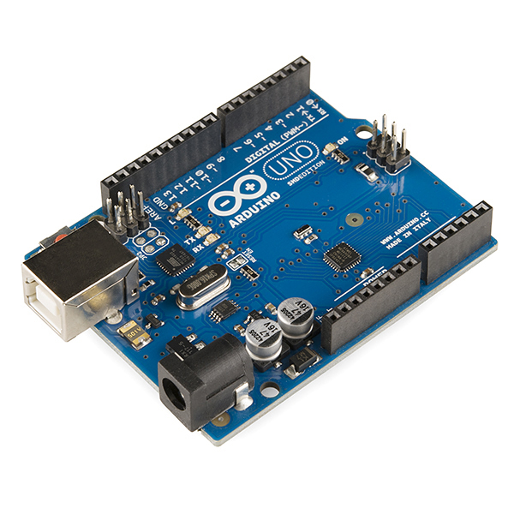
Arduino UNO
A programmable microcontroller
What can it be used for?
Internet of Things
Controlling lights/sensors/motors
Notes:
The Arduino Nano is a small, complete, and breadboard-friendly board based microcontroller
Nano has two extra analog pins
Good replacement for uno as it is breadboard friendly

Slide 4
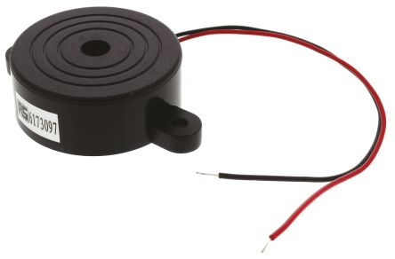
Piezo buzzer
A piezo buzzer produces sound when voltage is applied.
It consists of a piezo electric plate that produces sound.
It is used in vehicular horns
Notes:
*The HC-06 acts as a serial port through which you can send and receive data.
*So using a serial terminal or a Bluetooth customized application on your computer or phone, you can control and monitor your project.
*HC06 functions only as slave to a microcontroller

Slide 5
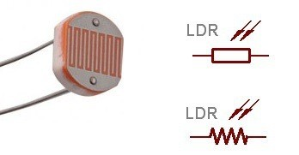
Light dependent resister (LDR)
A light dependent resister
has a (variable) resistance
that changes dependent on
the light intensity.
It is used in street lights.
Notes:
*L298N Dual H-Bridge Motor Controller module
*H-Bridge's are typically used in controlling motors speed and direction, but can be used for other projects such as driving the brightness of certain lighting projects such as high powered LED arrays.
*An H-Bridge is a circuit that can drive a current in either polarity and be controlled by *Pulse Width Modulation (PWM)
*Pulse Width Modulation is a means in controlling the duration of an electronic pulse
*Motors are rated at certain voltages and can be damaged if the voltage is applied to heavily or if it is dropped quickly to slow the motor down.
* The longer the pulses the faster the wheel will turn, the shorter the pulses, the slower the water wheel will turn.

Slide 6
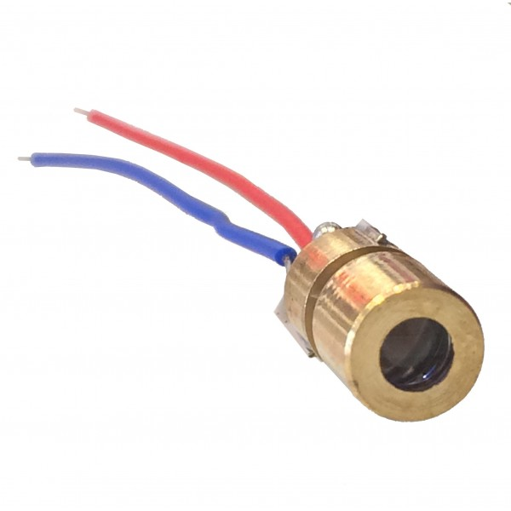
Laser diode
It is similar to light emitting diode that produces laser beam.
It is used in barcode readers,
laser printing and scanning.
Notes:
*The MPU-6050 is not expensive, especially given the fact that it combines both an accelerometer and a gyro.
Therefor it captures the x, y, and z cordinates at the same time.
The MPU-6050 always acts as a slave to the Arduino with the SDA and SCL pins connected to the i2C
Ad0 meant to access complex functionalities for the i2c programming but in our case we are grounding it.
The interupt pin of mpu6050 helps the microcontroller know that fresh data has been arrived in the register which can be read by the controller.

Slide 7
Now for the hardware…

Slide 8
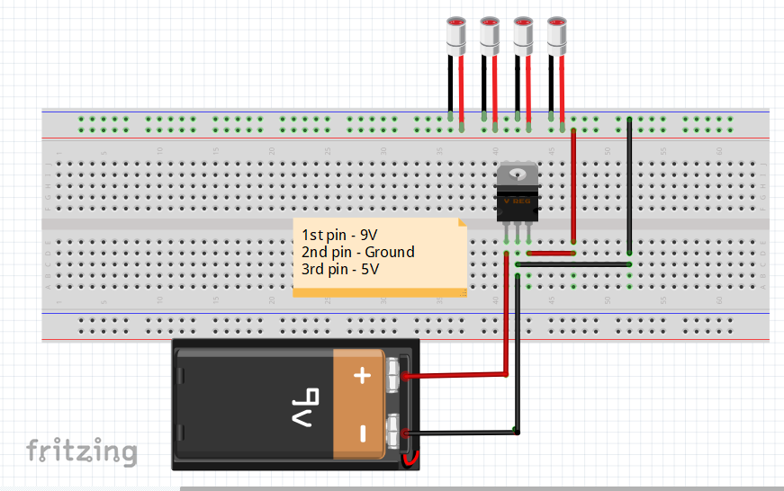

Slide 9
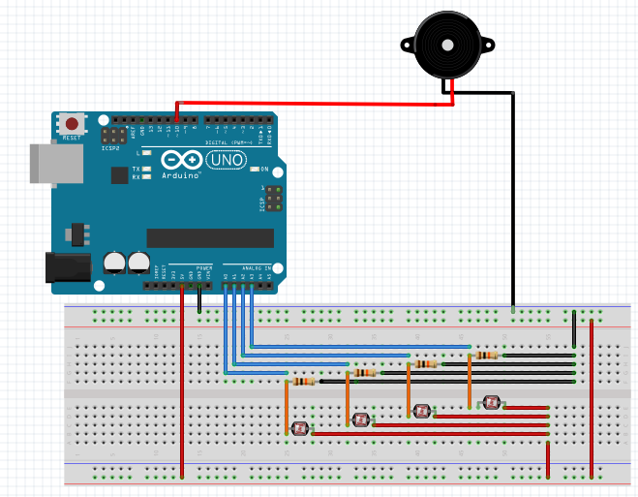
Buzzer – pin 10
LDR 1 – A0
LDR 2 – A1
LDR 3 – A2
Resistor – 1K

Slide 10

Testing the system
Download the Arduino IDE
Download the Arduino code and schematic at https://github.com/The-Assembly/Laser_Piano_Workshop

Slide 11

THANK YOU

